Slide 1
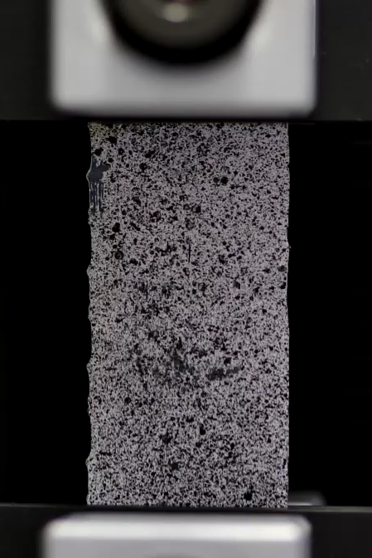
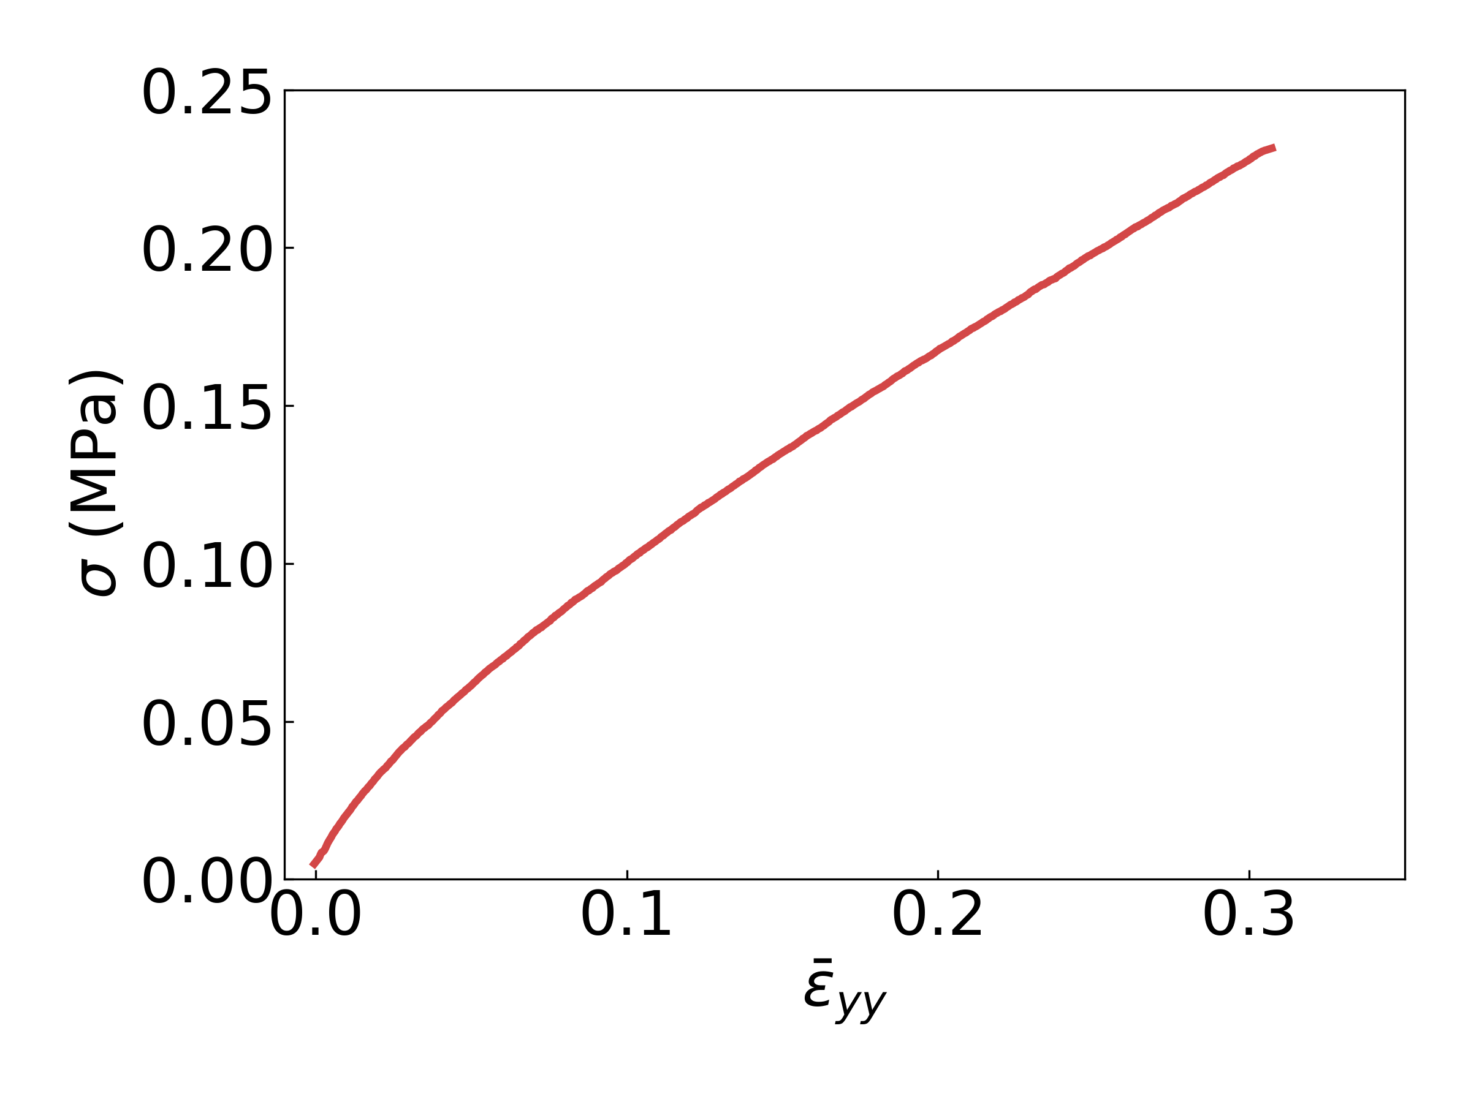
80 mm
exx
eyy
exy
2
1
2
1
E₁ = 2.2 Mpa
E₂ = 1 Mpa
Each square is 10mm x 10mm
1
2
1
2
2
1
2
1
1
2
1
2
40 mm
2
1
2
1
1
2
1
2
2
1
2
1
1
2
1
2

